Slide 1
Green Skills using AI Technologies.
Edunet Internship :

Slide 2
Submitted by:
Name : Parekh Darsh Sunilkumar
Enrollment Number : 231250116037
Stream : Information Technology
College Name : Shree Swaminarayan Institute of Technology
Internship: Edunet Foundation – Green Skills using A.I Technologies.

Slide 3
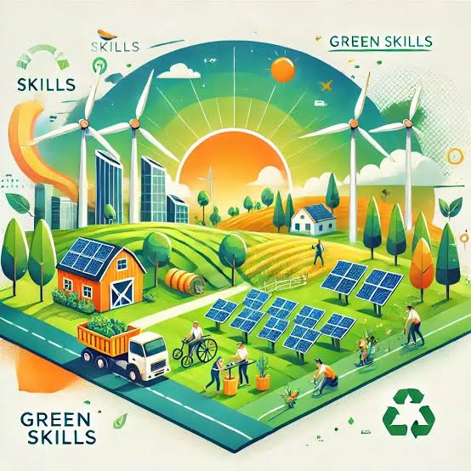
About Green Skilling:-
What is Green Skilling?
Green Skilling means learning skills that help protect the environment and support sustainable development.
Examples
Renewable Energy
Electric Vehicles
Recycling
Waste Management
AI for Environment
Smart Agriculture

Slide 4
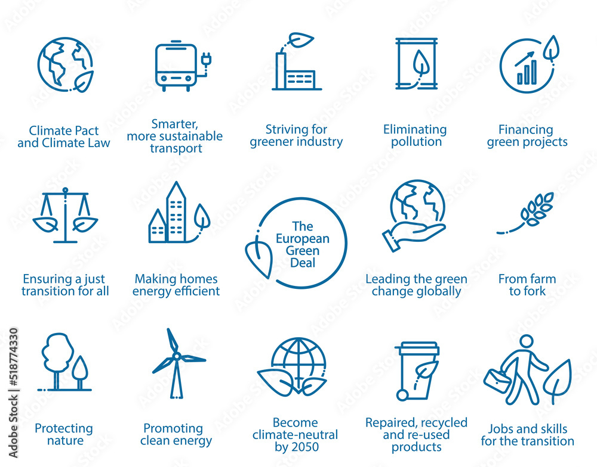
Sustainibility:-
What is Sustainability?
Sustainability means using natural resources responsibly so future generations can also meet their needs.
Three pillars:
Environmental Sustainability
Social Sustainability
Economic Sustainability

Slide 5
AI and Sustainability:-
AI helps Sustainability
Examples:
Smart waste segregation
Predicting floods
Forest monitoring
Air pollution prediction
Smart irrigation
Energy optimization
AI Challenges
Examples:
High electricity consumption
Large data centers use lots of power
Carbon emissions
Electronic waste
Water consumption for cooling servers

Slide 6
Things Learned from the Links:-
1. UN SDG Goals:
Sustainable Development Goals are 17 global goals.
They aim to end poverty, protect the environment and ensure peace.
SDG 13 (Climate Action) and SDG 17 (Partnerships for the Goals) are important.

Slide 7
Things Learned from the Links:-
2. Data Centre Video :
Watched the YouTube video.
Data centers store and process internet data.
They consume huge amounts of electricity.
Green data centers use renewable energy.
Efficient cooling systems reduce carbon emissions.

Slide 8
Things Learned from the Links:
3. Ecological Footprint Calculator :
Opened the calculator.
Took the quiz.
Measures environmental impact.
Calculates Earth's resources required.
Encourages sustainable lifestyle choices.

Slide 9
Things Learned from the Links:
4. Carbon Calculator :
Used it.
Estimates personal carbon emissions.
Shows impact of transportation and lifestyle.
Suggests methods to reduce emissions.
Took the screenshot.

Slide 10
Things Learned from the Links:
5. EcoTransit Emission Calculator :
Compares transport emissions.
Shows greener transportation options.
Useful for logistics planning.
Took the screenshot.

Slide 11
Things Learned from the Links:
6. MIT Climate Simulation :
Moved a few sliders.
Observed changes.
Simulates future climate scenarios.
Shows effect of renewable energy.
Helps understand global warming.
Took the screenshot.

Slide 12
Things Learned from the Links:
7. AI Smart Bins :
Visited website.
AI identifies different waste types.
Improves recycling.
Reduces landfill waste.

Slide 13
Things Learned from the Links:
8. Government EV Calculator :
Used the calculator.
Compares petrol vs electric vehicles.
Shows CO₂ savings.
Converts savings into equivalent number of trees.
Took the screenshot.

Slide 14
Things Learned from the Links:-
Favourite SDG – SDG 17:- Partnerships for the Goals:
I selected SDG 17 – Partnerships for the Goals because achieving sustainable development requires cooperation among governments, industries, educational institutions, NGOs, and individuals. Global challenges such as climate change, pollution, and resource conservation cannot be solved by one organization or one country alone. Strong partnerships help share knowledge, technology, funding, and innovative ideas to achieve the Sustainable Development Goals more effectively. Artificial Intelligence can support SDG 17 by enabling data sharing, improving communication, analyzing large environmental datasets, and helping organizations make informed decisions. My AI with Green Skills internship is itself an example of SDG 17, where educational institutions, Edunet Foundation, and technology partners collaborate to equip students with AI skills for building sustainable solutions.

Slide 15
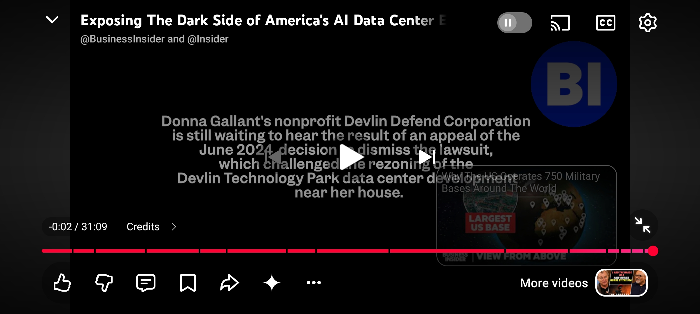
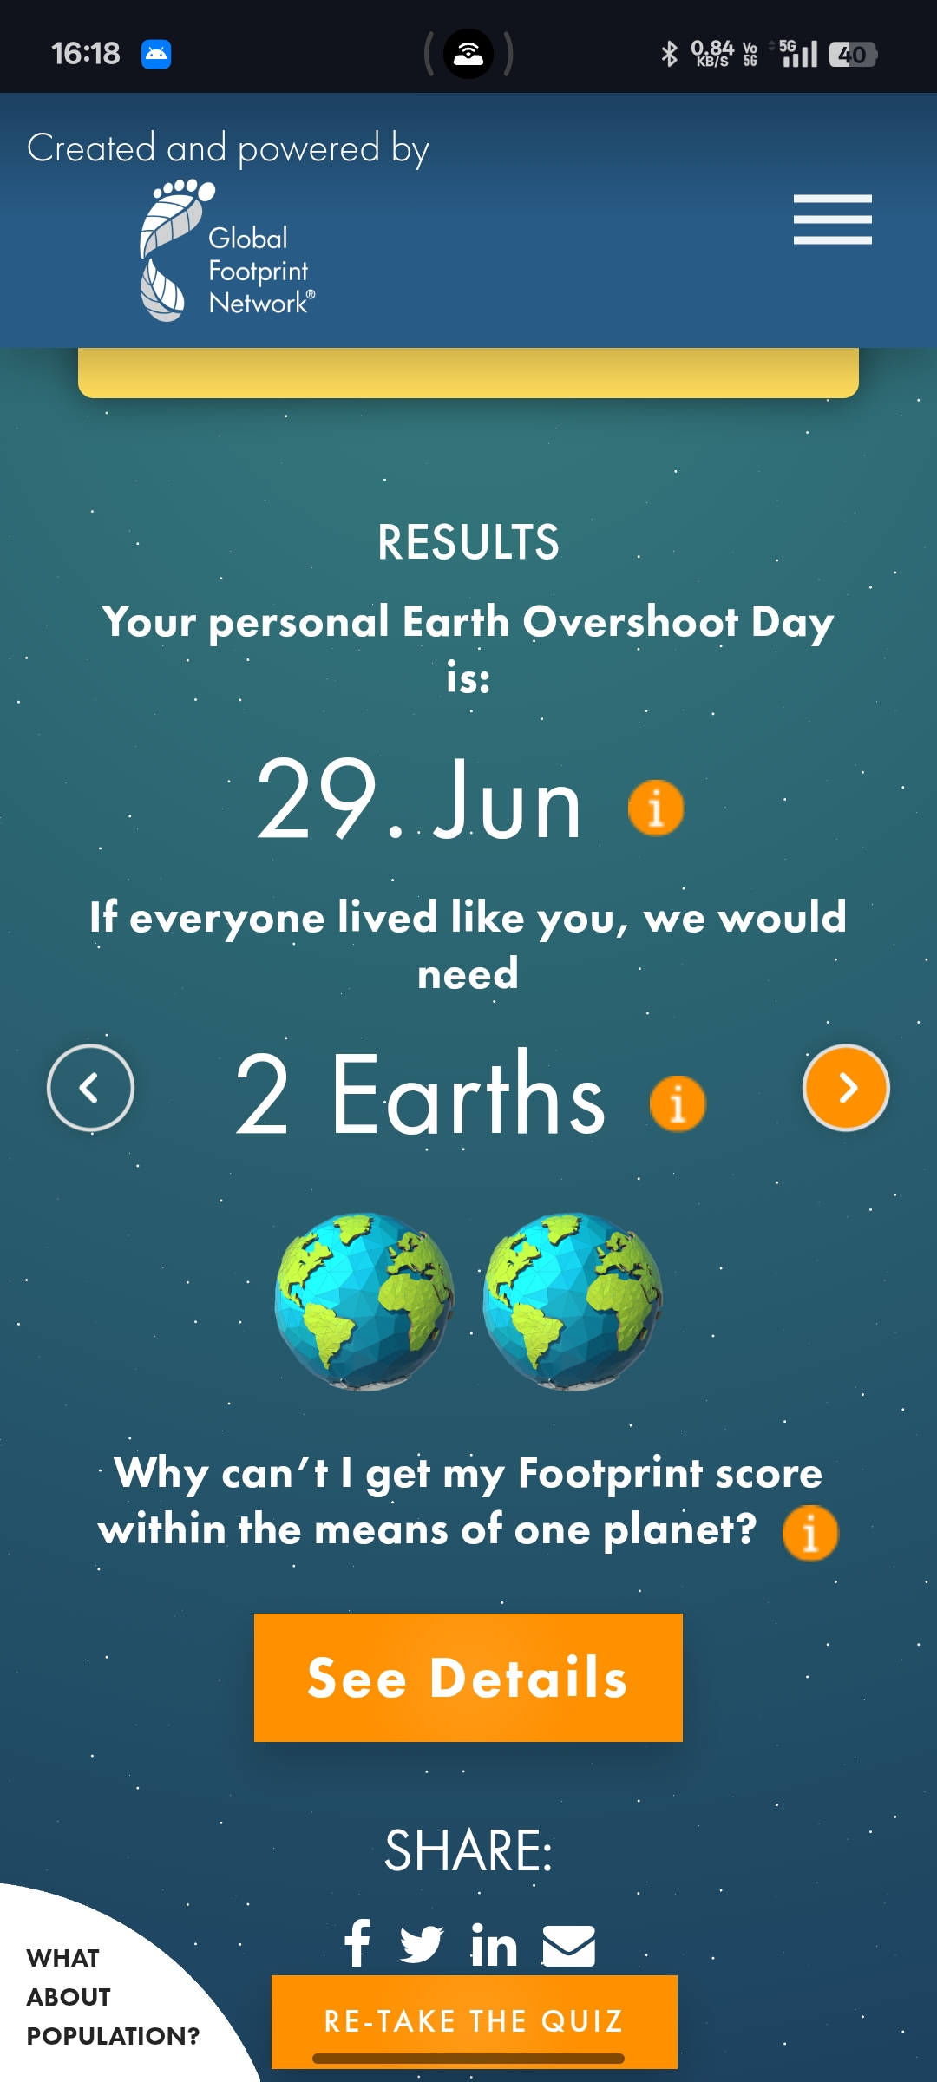
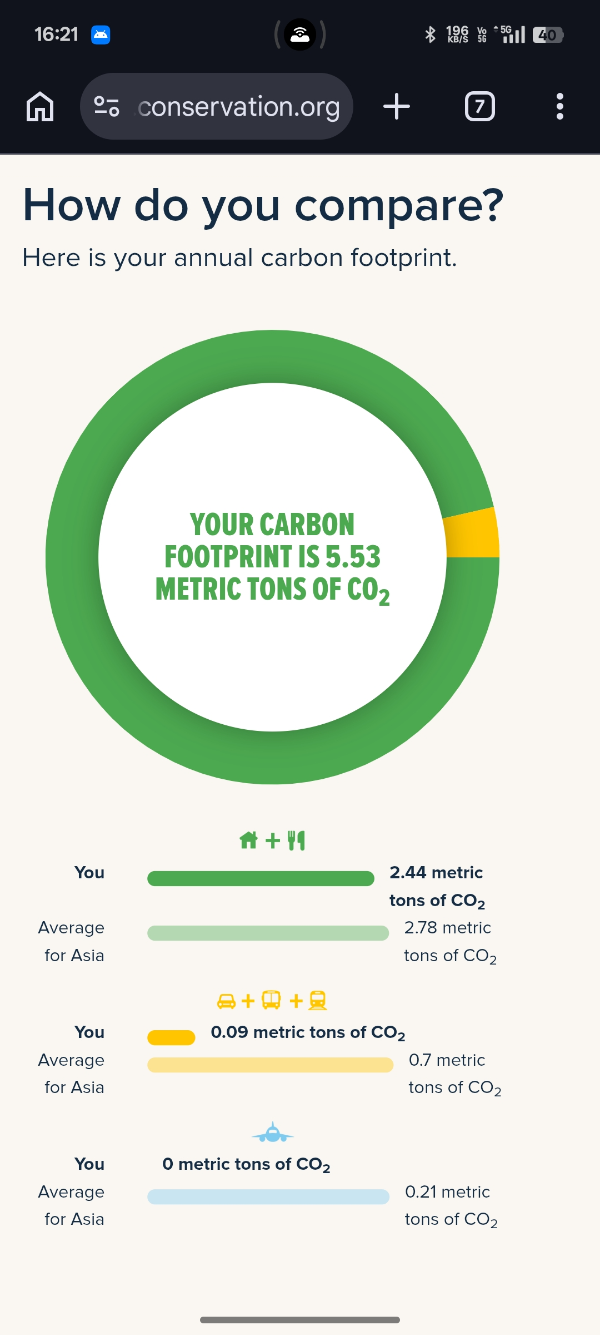
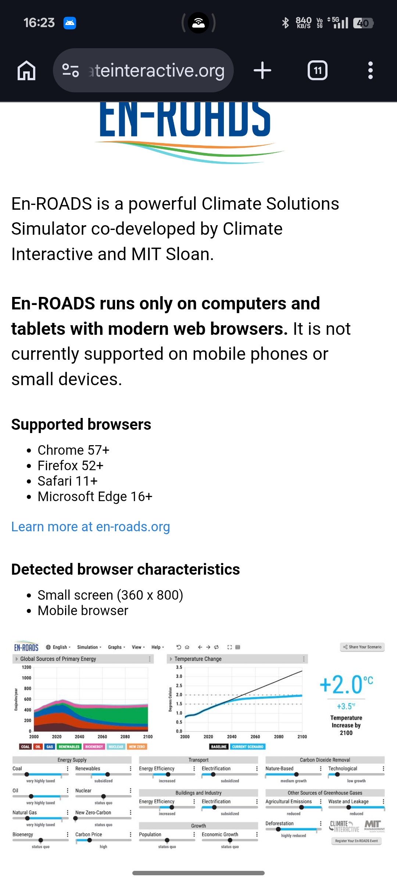
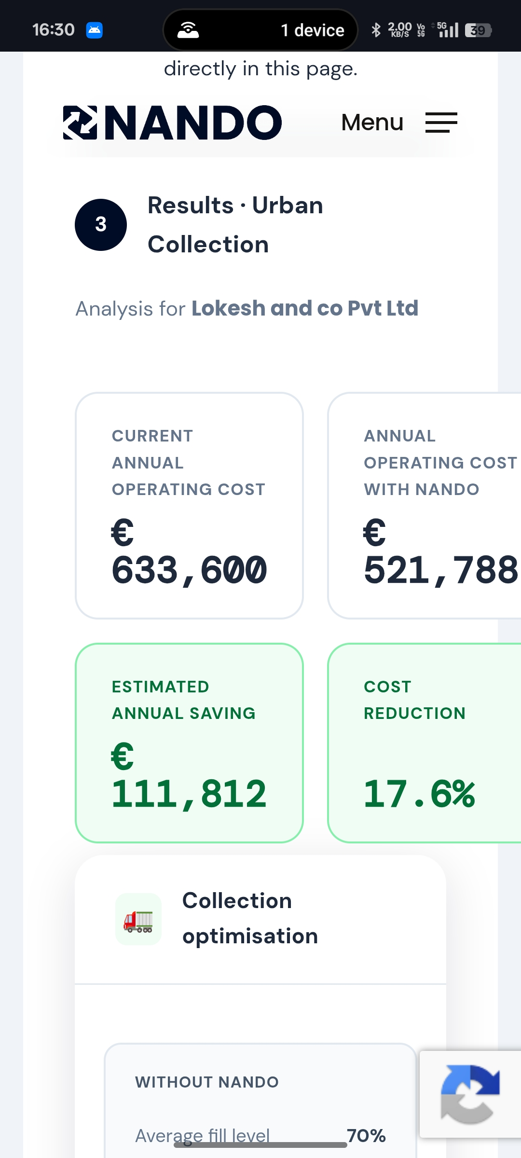
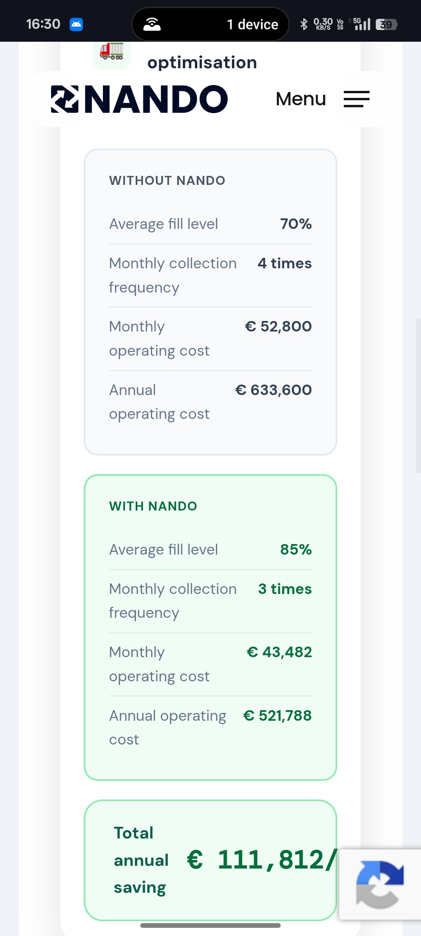
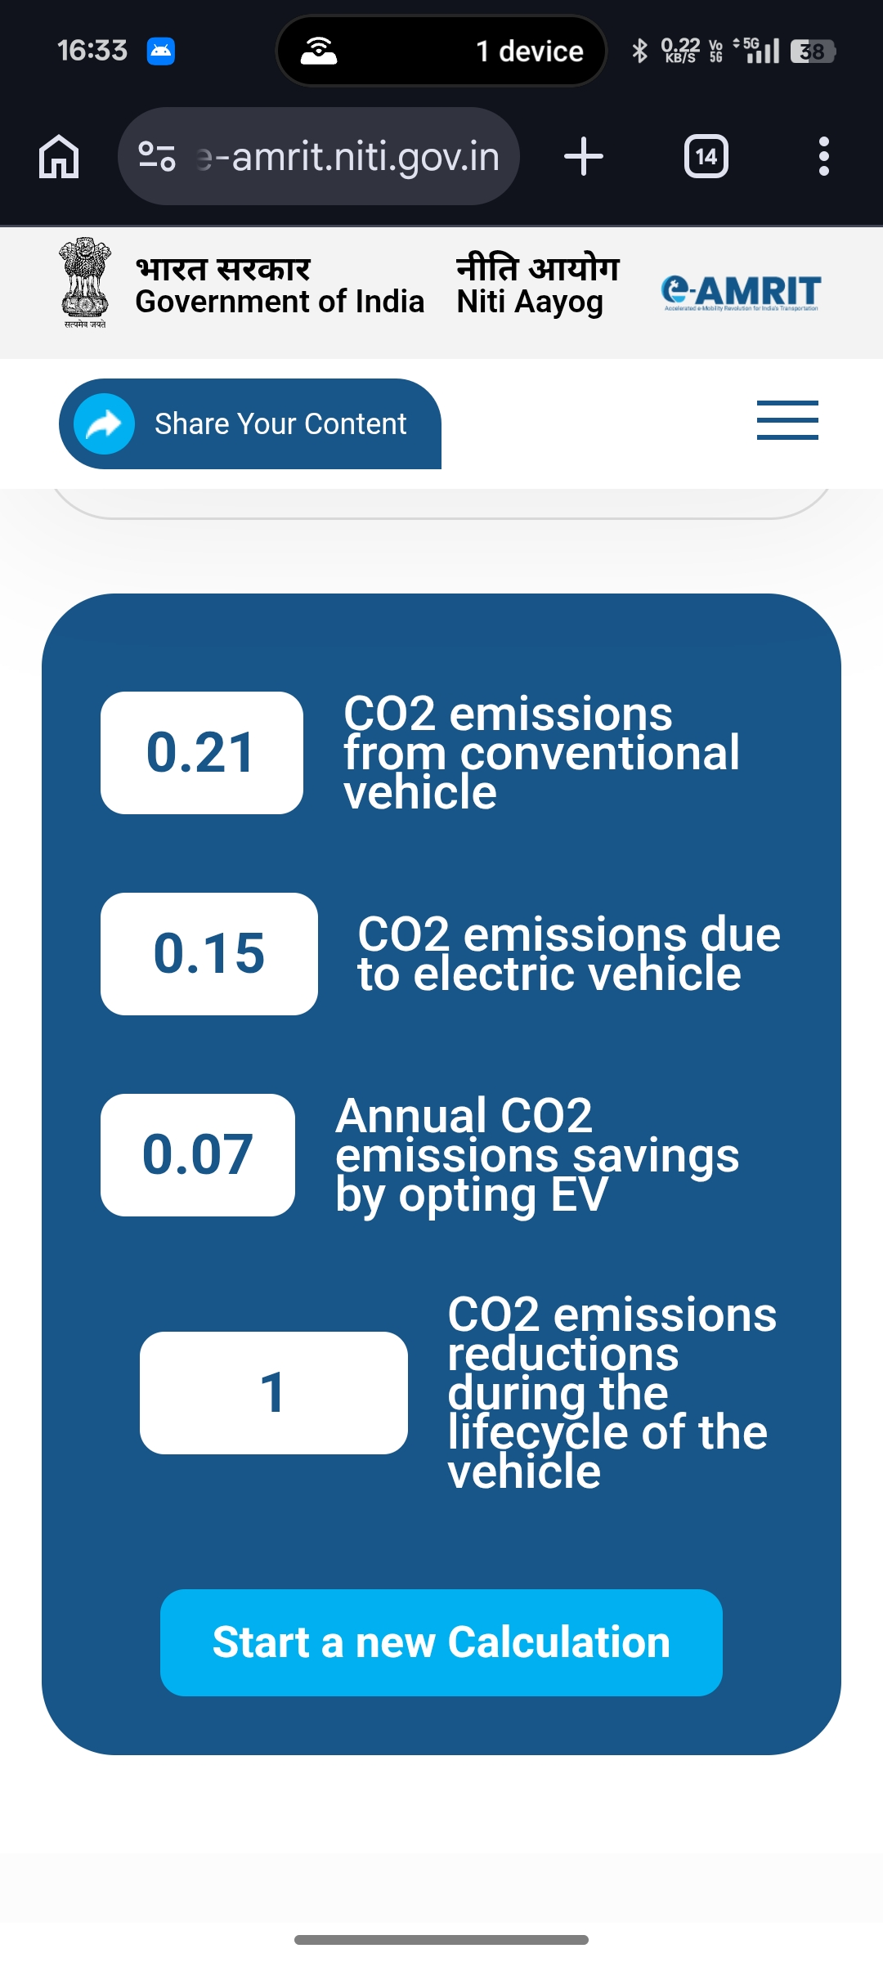
Screenshots(Activities Performed):-

Slide 16
Key Learnings:-
Learned about Sustainable Development Goals.
Understood Green Skilling.
Explored AI applications in sustainability.
Calculated ecological footprint.
Learned about carbon emissions.
Explored climate simulation.
Understood green transportation.
Learned how AI supports environmental protection.

Slide 17
Capstone Project Idea:-
Project Title:-
EcoHub AI : Intelligent Sustainability Analytics Platform
Project Description:-
EcoHub AI: Intelligent Sustainability Analytics Platform is an AI-powered platform designed to analyze environmental and sustainability data to support informed decision-making. It uses machine learning and data analytics to identify trends in areas such as carbon emissions, energy consumption, waste management, and resource utilization. The platform provides insights and visualizations that help individuals, organizations, and policymakers adopt sustainable practices and contribute to achieving the United Nations Sustainable Development Goals (SDGs).
Group Members:-
1. Darsh Parekh
2. Rutu Patel
3. Minakshi Patel
4. Nija Mavani
5. Kovid Bhujbal

Slide 18
Thank You.

